Slide 1
Assignment 3
<210040139>,<3rd Year>, <Mech>
<210050001>,<3rd Year>, <CSE>
<210050126>,<3rd Year>, <CSE>

Slide 2
Problem Statement
Perform Named-Entity Identification using SVM classifier with appropriate feature engineering
Technique to be used: SVM classifier
Dataset: CoNLL NER Data; https://paperswithcode.com/dataset/conll-2003 and
https://huggingface.co/datasets/conll2003 (they are same data, but have common and distinct
information)

Slide 3
Problem Statement
Input: A sentence
Output: Name-No Name tagged for each word in the sentence
Example:
Input: Delhi is the capital of India.
Output: Delhi_1 is_0 the_0 capital_0 of_0 India_1 ._0

Slide 4
Data PreProcessing
Tokenization : Given a sentence, we have first applied tokenization to the sentence.
For this we used nltk.tokenize.word_tokenize function. Given an input sentence in the above function, it gives a list of all the tokens, for eg.,
nltk.tokenize.word_tokenize(‘I am going to school.’) will give -
[‘I’, ‘am’, ‘going’, ‘to’, ‘school’, ‘.’]
No change in case : Case is very important in the feature extraction. Hence changing case for preprocessing, hence changing case is not good as a PreProcessing step for NER.

Slide 5
Feature Engineering
Used total 9 features, hence made a 9 dimensional feature vector for each word. Here are the features used :
Case of First letter of each word : Value is 1 if the first letter of the word is an uppercase letter, else 0. Generally it is seed that named entities have first letter capital, like person’s name, eg. , Ram in the sentence - ‘I met Ram in the market’.
Point to note : Not all words starting with capital letters are named
entities, like I in the above sentence is not a named entity.

Slide 6
Feature Engineering
Case of the whole word : If the word is in uppercase completely, there is a good chance that it is a named entity. This is particularly true for acronyms like USA, WHO, etc.
Point to note : In language, one can often use an all Uppercase word to depict an order, etc. So this metric is not correct at all times.
Word in stopwords from nltk : A stop word is a commonly used word (such as “the”, “a”, “an”, “in”) that a search engine has been programmed to ignore, both when indexing entries for searching and when retrieving them as the result of a search query.
nltk library has a set of stopwords, and this feature is checking whether the word is in the set of stopwords or not.

Slide 7
Feature Engineering
Punctuation Marks : Feature used to check whether a word is not a word but a punctuation mark. Punctuation marks are not named entities.
POS Tag of current word : Feature which depends on the POS Tag of the word in the sentence. Pronouns are more likely to be a named entity whereas verbs are least likely to be named entities. Used nltk pos_tag for giving out POS Tags to words in the test sentence.
POS Tag of previous word : Feature which takes into account the POS Tag of the previous word in the sentence. If no previous word is there, this feature is assigned a value equal to the POS tag of ‘.’ .

Slide 8
Feature Engineering
POS Tag of next word : Feature which takes into account the POS Tag of the next word in the sentence. If no next word is there, this feature is assigned a value equal to the POS tag of ‘.’ .
Last letter of the word : Used to check whether the last letter is a consonant or a vowel. It is noted that, consonants are more common to be the last letter in named entities. This rule is not correct everywhere and has its set of exceptions.
Word not the name of a month or a day : One of the most misclassified set of words after applying the above 8 features is that of day names like Monday, Tuesday, etc. and month names like April, May, etc. These words usually start with a capital letter but are not named entities. This feature tests if the word is one of the above.

Slide 9
Models used
Model used is SVM from sklearn module. (sklearn.svm.SVC())
There are many hyperparameter settings used and F scores for each setting were calculated on the validation set. Some of these include :
SVM with kernel = ‘Linear’ and C = 0
SVM with kernel = ‘Linear’ and C = 1
SVM with kernel = ‘rbf’
There was negligible difference between the F-scores of these 3 models.

Slide 10
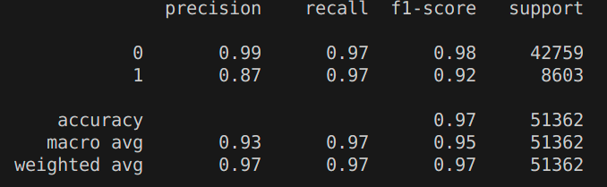
Results
These are the results of the best model - SVM with linear kernel and C = 0 on the validation set

Slide 11
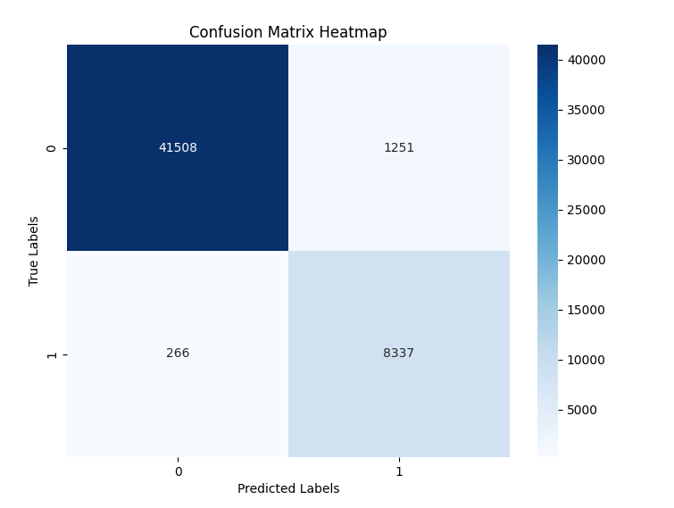
Results
This is the confusion matrix for SVM classifier predictions on the validation set

Slide 12
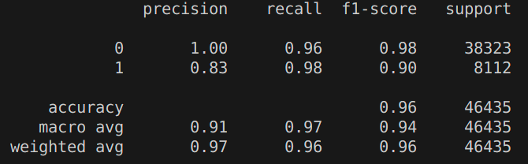
Results
These are the results of the best model - SVM with linear kernel and C = 0 on the test set

Slide 13
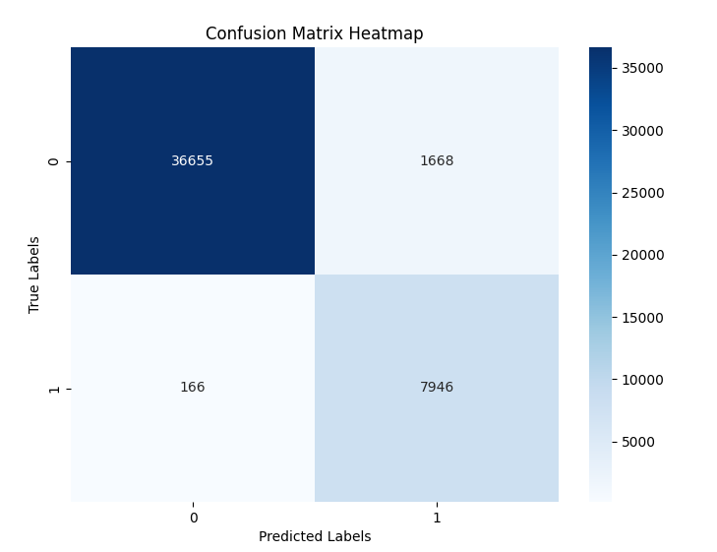
Results
This is the confusion matrix for SVM classifier predictions on the test set

Slide 14
Error Analysis
In Named Entity Recognition task, one of the major learnings was the use of capital letters. NER is quite dependent on the case of the letters. If the first letter is a capital, then it is quite a good chance that the word is a Named entity. Checking for first letter case makes our precision for class 1 = 72 % on validation set.
The second major improvement for this task was checking whether the word was one of the stopwords, names of months, name of days, etc. If they were, they aren’t Named Entities. Infact, this improvisation skyrockets the precision of ‘class 1’ labels by approx 10-12 %

Slide 15
Error Analysis
We have got recall values for both ‘class 1’ and ‘class 0’ above 0.95 in test set which signifies that recall rates are quite good. Precision value of ‘class 0’ is approx 1. But the main underlying point is the precision value of ‘class 1’. It is quite good at 0.83 for the test set. Reason for it not reaching close to 1 is some misclassifications of ‘class 0’ as ‘class 1’.

Slide 16
Error Analysis
Some such misclassifications involve the first word of the sentence. First letter capital is a very important and significant feature for NER. But the starting word of the sentence generally starts with a capital letter. Such words are quite likely to be misclassified.
Also words with all capitals and not Named Entity are also likely to be misclassified. There are many Named Entities with all letter capital. So it is good that these are classified as Named Entities by our model. But there are words with all capitals conveying something important in sentence or perhaps depicting an order, which tend to be misclassified.

Slide 17
Learnings
NER is a task where we require both low level language features such as last letter tagging of vowels/consonants and higher level features such as syntactic information such as POS Tags. Also manual rule based feature extraction (i.e, whether the word is not in stopwords, names of months, etc) is very helpful for improving overall performance of the model. Infact, some properties like Case of a word which doesn’t have anything to do with the speaking part of the language is one of the major features in feature extraction which helps in NER.
As such NER gives us insight into practical ML - the way of testing and retesting things out while combining both lower and higher level language features to solve certain NLP tasks.

Slide 18
Thank You

